Slide 1
Fitness Effects of Horizontal Gene Transfer from Wolbachia to Drosophila and Method Development and Implementation of Phylogeny Analysis Software
Developers: Olga Better, Kaitlin Klotz, and John Patterson

Slide 2
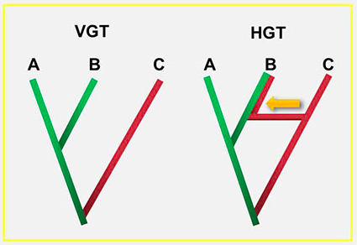
Introduction
Horizontal Gene Transfer (HGT): The transmission of portions of the genome from an organism of one species into the genome of another species.
HGT introduces novel genes into species. These genes may insert in the middle of coding sequences, interrupting the naturally-occurring genome or creating entirely new genes, or they may insert in regulatory sequences, altering how genes are expressed.
New genes may confer a new phenotype on the recipient species. These new phenotypes may exhibit a change in fitness for the recipient species.
https://steemit.com/science/@starbrush/horizontal-gene-transfer-hgt-and-dna-restructure
Notes:
Olga

Slide 3
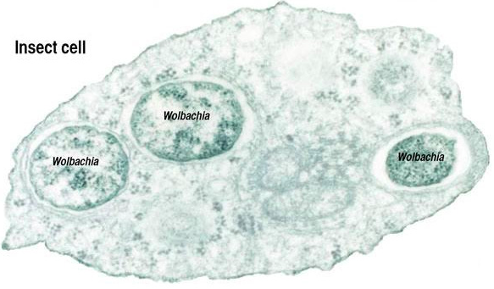
Introduction
Wolbachia is a parasite that invades insects (i.e. Drosophila) and inserts part of its genome into the host organism.
The Wolbachia gene insertions cause feminization of male Drosophila, rendering them sterile (McGraw and O’Neill, 2003).
http://babec.org/wolbachia-pcr/
Notes:
Olga
Wolbachia-infected female flies transmit the parasite to uninfected males in mating encounters and to all of their offspring.

Slide 4
Introduction
Infection with Wolbachia also causes cytoplasmic incompatibility, which results in gametes of both sexes of Drosophila being unable to produce viable offspring between species (Zabalou et. al., 2004).
Cytoplasmic incompatibility causes reproductive isolation.
The mechanisms of cytoplasmic incompatibility are not well known, but studies have shown that transfer of mitochondrial elements may play a role (Marshall, 2004).
Notes:
Olga

Slide 5
Significance
We don’t fully understand how the new genes formed by parasitic HGT affect phenotype-this has been the subject of research in the Rogers Lab at UNCC (Rogers et al, 2014).
We don’t understand how cytoplasmic incompatibility is conferred from parasite to host-this is an area of research closely tied to insect population control and disease containment.
Notes:
Kaitlin

Slide 6
Significance
In addition to fruit flies, Wolbachia infects mosquitoes (particularly, Aedes aegypti).
Once infected with Wolbachia mosquitoes mate, then infected females transmit the parasite to their offspring rendering infected males sterile (Bost, 2016).
Unknowingly mating with sterile, infected, males the the disease is transmitted to healthy females. While no offspring are produced from this mating encounter, the parasite lives within the female until she successfully reproduces and passes along to her progeny.
Both male and female progeny are born infected with Wolbachia.
Notes:
Kaitlin

Slide 7
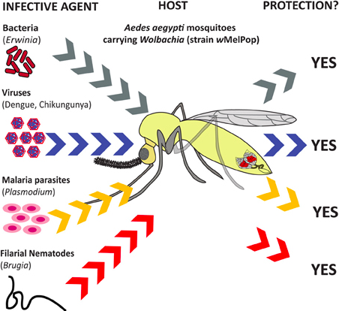
Significance
While this may not seem significant from the previous information, it provides humans with a method of mosquito population control.
Scientists infect male mosquitoes (who are sterilized) and then release them.
The sterile males will mate and infect females without producing offspring.
Applicable to any pest that wolbachia can parasite.
https://www.frontiersin.org/articles/10.3389/fphys.2013.00046/full
Notes:
Kaitlin

Slide 8
Significance: Summary
When the infected females mate with healthy males, they will further transmit the disease leading to a larger sterile proportion of the population and hence, an eventual decrease in the total number of mosquitoes (Bost, 2016).
An understanding of exactly how insect hosts of Wolbachia become feminized may be leveraged against mosquitoes to enhance efficiency of the sterilization process. Intuitively, with fewer total mosquitoes, there are fewer opportunities for mosquito-borne disease to be transmitted to humans and livestock.
Our software package will utilize predictive modeling with rational design to facilitate researchers in visualizing where gene insertions occur.
Notes:
Kaitlin

Slide 9
Novelty and Contributions
Goal: Produce a package that takes reference genomes and raw experimental genomes to analyze for insertion of Wolbachia DNA into host organism genomes.
Currently, the code used to distinguish novel mutations in the Drosophila genome as a result of Wolbachia HGT exist in four separate Python files that we are converting to OOP one at a time and testing.
We are further developing the existing code into a package for use by non-programmers.
While the original scripts are relatively simple to understand for users with a basic background in Python programming, they would not mean much to non-programmers.
This is our own original class that utilizes methods to achieve an output list of novel genes from Wolbachia to Drosophila HGT.
Notes:
Kaitlin

Slide 10
Novelty and Contributions
The improvements we are making to the existing project are the universalization of the code for application to genera of host/pathogen outside of Drosophila/Wolbachia and the implementation of a GUI.
The GUI will provide an easy-to-use version of the procedural scripts in which biologists can input their genome files and receive a list of potential mutations that they can then focus their studies to target for phenotypic contribution.
These additions/improvements to the current code serve to make genomic techniques more accessible to a wider range of academic researchers.
Notes:
Kaitlin

Slide 11
Methods: Code Conversion
To achieve our end goal of a user-friendly GUI to identify and list novel mutations conferred to Drosophila by Wolbachia, we created a BAM file parser to extract only lines containing the NCBI reference genome ID NC_002978.6 (Wolbachia endosymbiont of Drosophila melanogaster, complete genome) and converted the runtime scripts to OOP (Wu et al., 2004).
Notes:
John

Slide 12
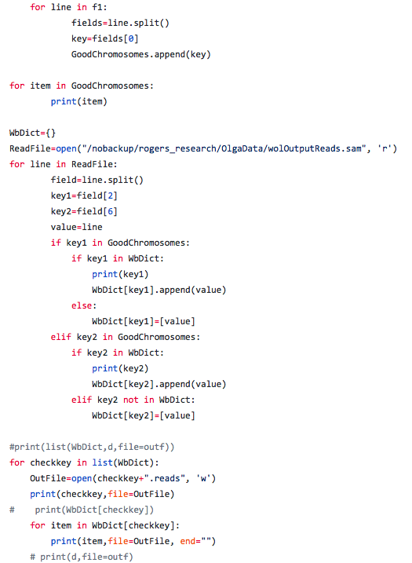
Methods: Code Conversion-The Before Picture
The wolbachia_dic.py script in its original procedural inline code.

Slide 13
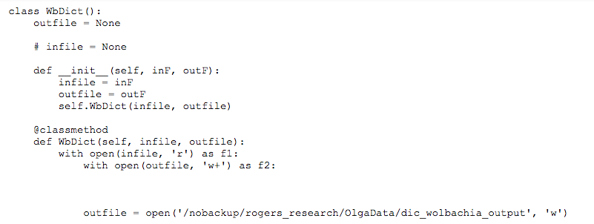
Methods: Code Conversion-The After Pictures (OOP)
Establishes WbDict as the class and initializes it with an infile and outfile.
Sets up the class method WbDict that will be called outside the class in order to produce the dictionary.

Slide 14
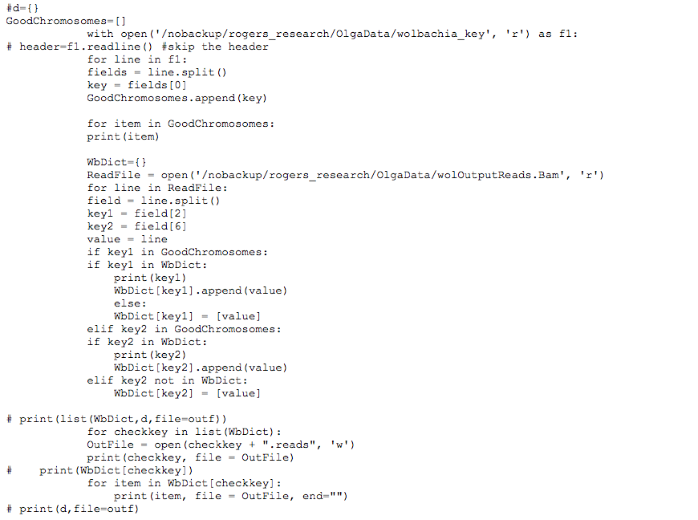
Methods: Code Conversion-The After Pictures (OOP)
The list GoodChromosomes is populated by field [0] of a data file from the Rogers Lab.
The dictionary WbDict is composed of entries that have two possible keys and a value. The keys are taken from fields [2] and [6] of a Roger’s Lab BAM file and the value is taken from the lines of the BAM file.

Slide 15
Methods: Code Conversion-The After Pictures (OOP)
If Key 1 is in both the WbDict and GoodChromosomes list, the key is printed out then appended to its value.
If Key 1 is not in both the WbDict and Good Chromosomes list, the key is not appended to a value but the key returns the value.
If Key 2 is in both the WbDict and the GoodChromosomes list, the key is printed out then appended to its value.
If Key 2 is not in both the WbDict and Good Chromosomes list, the key is not appended to a value but the key returns the value.

Slide 16
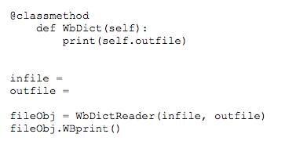
Methods: Code Conversion-The After Pictures (OOP)
Finally, the class method defined earlier is called and the WbDict is printed in the outfile.

Slide 17
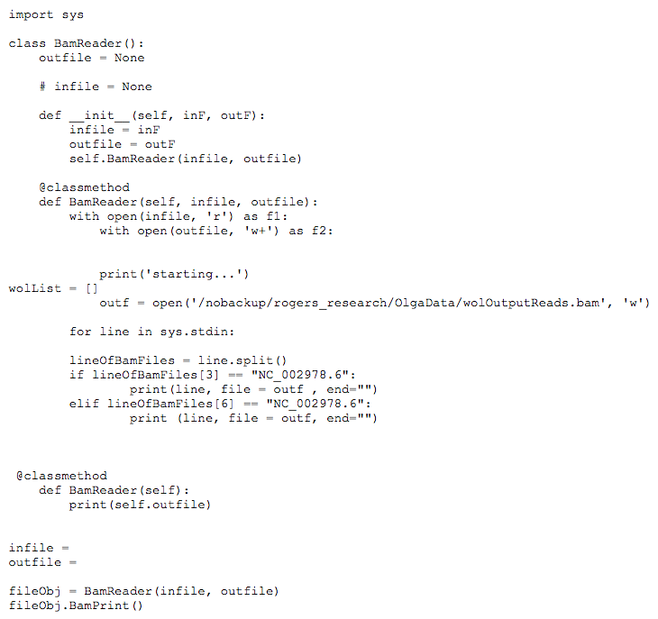
Methods: Creating a BAM File Parser
Once the lines containing NC_002978.6 were parsed from the original BAM file, they were written to an outfile, therefore, a list of Drosophila genes in which Wolbachia genetic information had been detected could be produced.

Slide 18
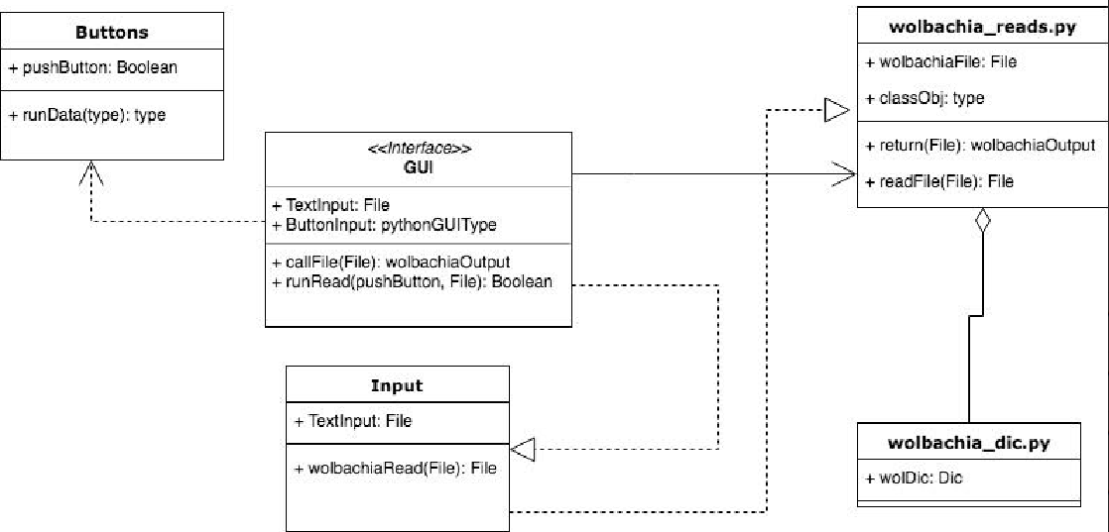
Methods: Making a GUI
Next, we used a the TKinter GUI module to produce a GUI that is easily navigated by non-programmers.
TKinter was chosen for its accessibility and compatibility with python classes as well as hardware. (Python 3.6.4 Documentation)
TKinter is a built in GUI module for Python. (Python 3.6.4 Documentation)
Notes:
John

Slide 19
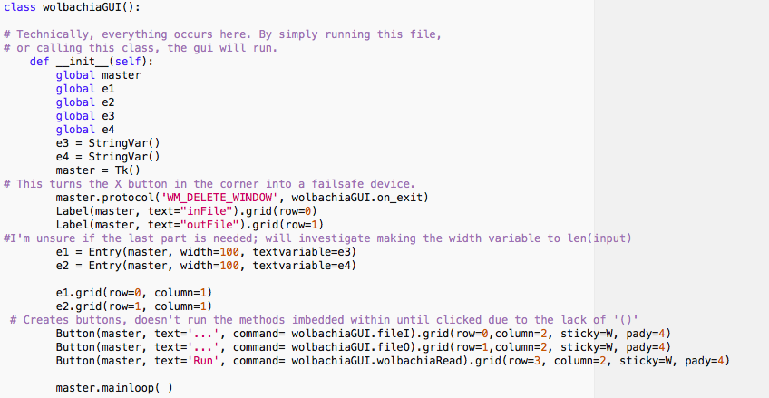
Methods: GUI Code
Establish the wolbachiaGUI, reads/creates files, and calls the rest of the pipeline.
Setting parameters for the input/output files.
Creating and naming the GUI’s buttons.

Slide 20
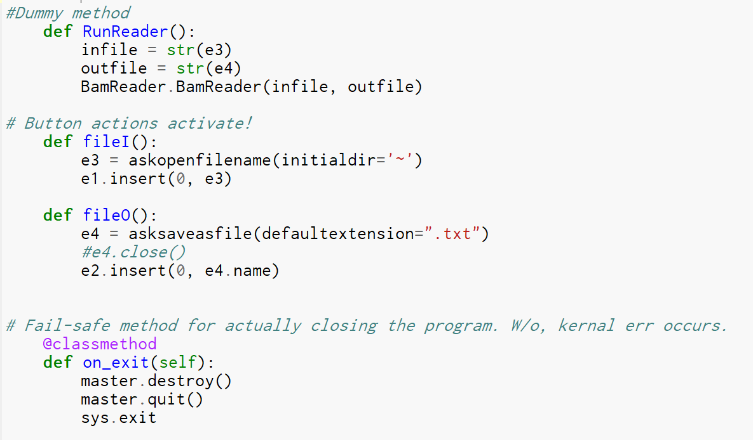
Methods: GUI Code
Methods created for file i/o added into the GUI. Opens native file browser for utility.
Built-in safety net for end user.
Finally, the actual method to run the pipeline is thrown into a facade.

Slide 21
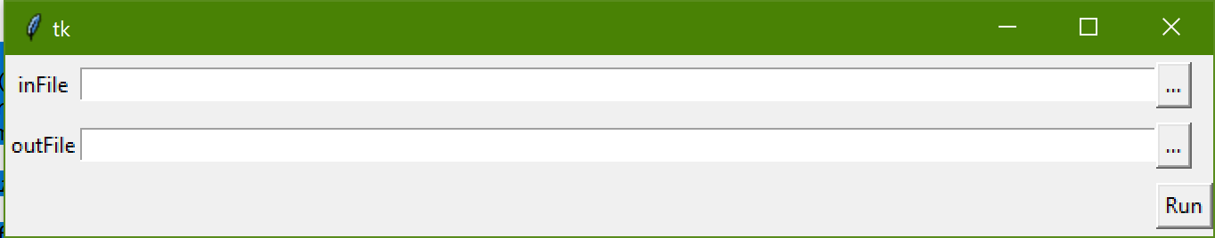
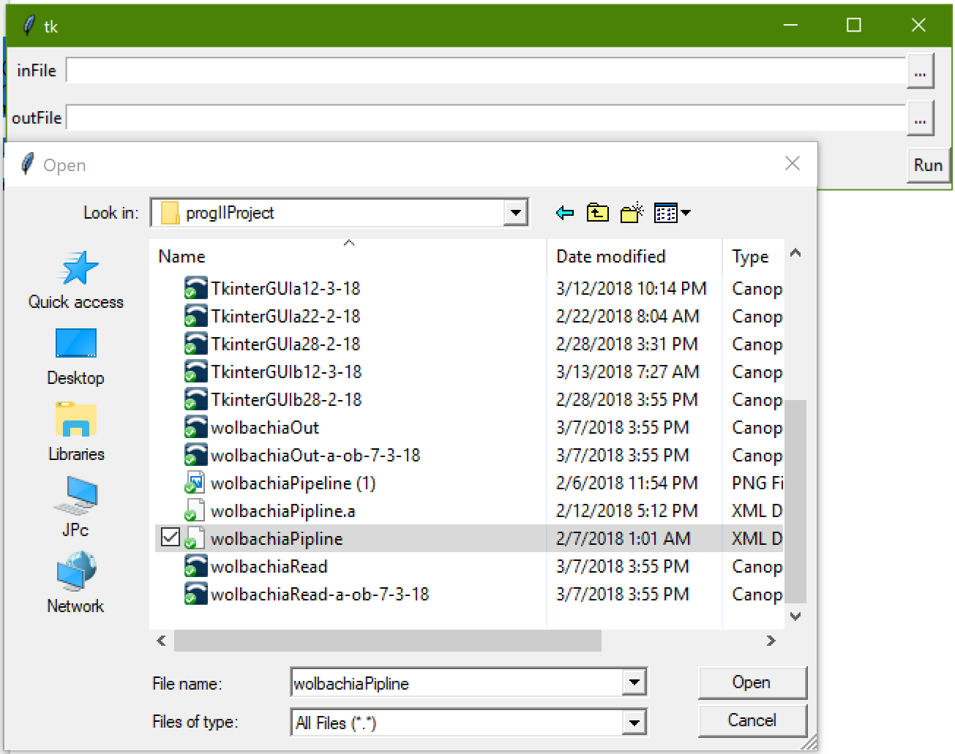
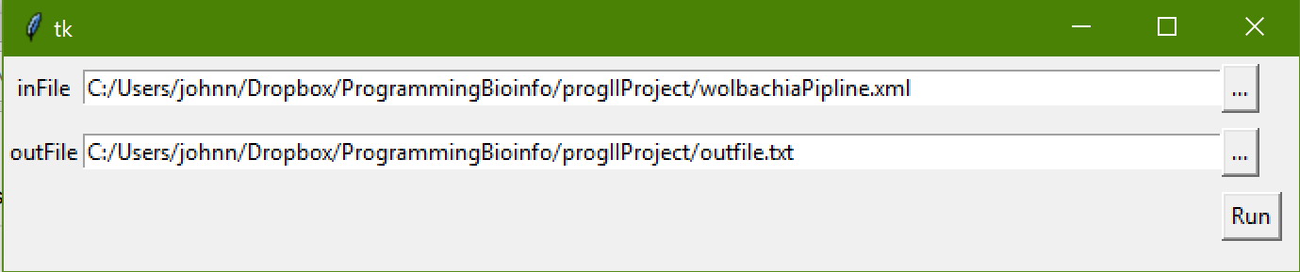
Methods: GUI
Methods created for file i/o added into the GUI. Opens native file browser for utility.
Built-in safety net for end user.
Finally, the actual method to run the pipeline is thrown into a facade.

Slide 22
Methods: Using the GUI
From the GUI interface, a “gene list” of likely HGT mutated Drosophila genes will be returned.
The output list is a listing of FlyBase fly genome database entries. (FlyBase, 2018)
Possible Extension: Produce a gene list that can be incorporated into multiple evolutionary gene/protein relationship databases.
For example, pushing this software’s output into PANTHER to determine any evolutionary relationships between potential mutants and their protein products. (Mi et al., 2016)

Slide 23
Results
Functional GUI
With rational design in mind, the GUI can find the input file and create a location and name for the output file.
It takes the arguments inside the BAM reader class then parse files for a particular genome ID for use in analysis.
Converted wolbachia reading, writing, and dic classes for incorporation into OOP package
Moving from scripts to inline also has allowed for possible external module inclusion, as mentioned.

Slide 24
Up Next
Incorporating all of the converted runtime scripts into the GUI’s functionality.
Testing the GUI with all converted runtime scripts with different data
i.e. Drosophila BAM files from different research groups or genome files from different organisms such as Anopheles mosquitoes.

Slide 25
References
McGraw, Elizabeth A, and Scott L O'Neill. “Wolbachia Pipientis: Intracellular Infection and
Pathogenesis in Drosophila.” Current Opinion in Microbiology, Elsevier Current Trends, 29 Dec. 2003, www.sciencedirect.com/science/article/pii/S1369527403001681.
Zabalou, Sofia, et al. “Natural Wolbachia Infections in the Drosophila Yakuba Species
Complex Do Not Induce Cytoplasmic Incompatibility but Fully Rescue the WRi Modification.” Genetics, Genetics, 1 June 2004, www.genetics.org/content/167/2/827.
Marshall, Jeremy L. “Article Access.” BioOne, Nov. 2004,
www.bioone.org/doi/pdf/10.1554/04-283.
Rogers, Rebekah L., et al. “Landscape of Standing Variation for Tandem Duplications in
Drosophila Yakuba and Drosophila Simulans | Molecular Biology and Evolution | Oxford Academic.” OUP Academic, Oxford University Press, 7 Apr. 2014, academic.oup.com/mbe/article-abstract/31/7/1750/2925730/Landscape-of-Standing-Variation-for-Tandem.
FlyBase. “FlyBase Homepage.” FlyBase Homepage, U.S. National Institutes of Health, 1 Mar.
2018, flybase.org/.
Bost, Kenneth. “Lecture 9 Dengue-2.” Epidemics and Plagues . Epidemics and Plagues Class
Huaiyu Mi, Xiaosong Huang, Anushya Muruganujan, Haiming Tang, Caitlin Mills, Diane Kang,
and Paul D. Thomas, Nucl. Acids Res. (2016) doi: 10.1093/nar/gkw1138
Wu, M, et al. “Wolbachia Endosymbiont of Drosophila Melanogaster, Complete Genome - Nucleotide -
NCBI.” National Center for Biotechnology Information, U.S. National Library of Medicine, 2004, www.ncbi.nlm.nih.gov/nuccore/NC_002978.6.
“25.1. Tkinter - Python Interface to Tcl/Tk¶.” 25.1. Tkinter - Python Interface to Tcl/Tk - Python
3.6.4 Documentation, Python Software Foundation, docs.python.org/3/library/tkinter.html.

